Slide 1
Exercise Data Analytics with R: Data Preprocessing in R
Exercises
Big Data in Medical Informatics
Dr. Oya Deniz Beyan
beyan@dbis.rwth-aachen.de
Kefang Ding
kefang.ding@rwth-aachen.de

Slide 2
Outlines
data exploration
data visualization
data cleaning
data sampling
data normalization
data standardization

Slide 3
Data Exploration
head(data, n=6)
tail(data,n)
attributes() list or change attributes of an object
summary()
numeric variables minimum, maximum, mean, median, and the first (25%) and third (75%) quartiles
categorical variables (factors): frequency of every level
mean() , median(), range(), quantile()
Notes:
head()/ tail() : Returns the first or last parts of a vector, matrix, table, data frame.
attributes() : These functions access an object's attributes. The first form below returns the object's attribute list.
attributes()<- value : change attributes of object

Slide 4
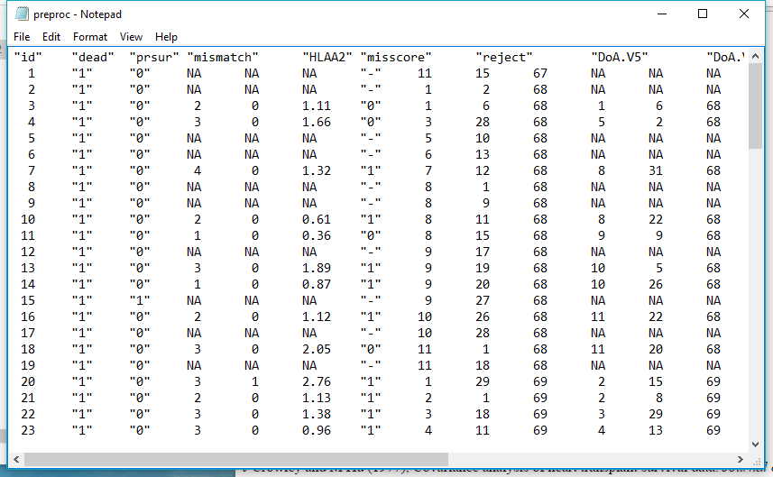
Dataset Example the Stanford Heart Transplant data[1,2]
id: patient id
dead: dead or alive
prsur: prior surgery 1=yes,0=no
mismatch: Number of mismatch
HLAA2: particular type of misscore
mismatch score: a measure of the degree of dissimilarity between donor and recipient
reject: reject of the transplant
DoA: Date of Accept
DoT: Date of Transplant
Notes:
prsur: Previous open-heart surgery for each patient
There are some explaination about the data.
https://support.sas.com/documentation/cdl/en/statug/63347/HTML/default/viewer.htm#statug_phreg_sect049.htm
Some medical terms are not easy to understand..But I think it's no big deal right now..

Slide 5
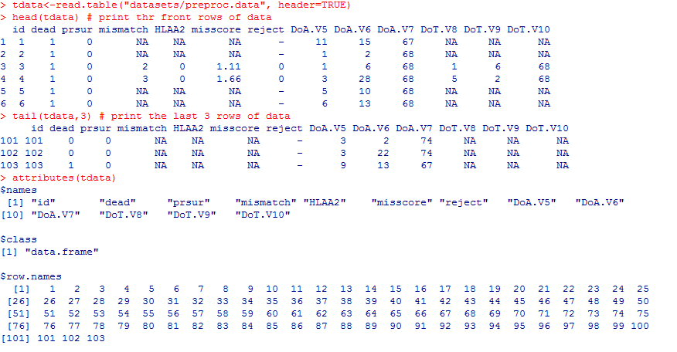
Data Exploration
Notes:
Data Description:

Slide 6
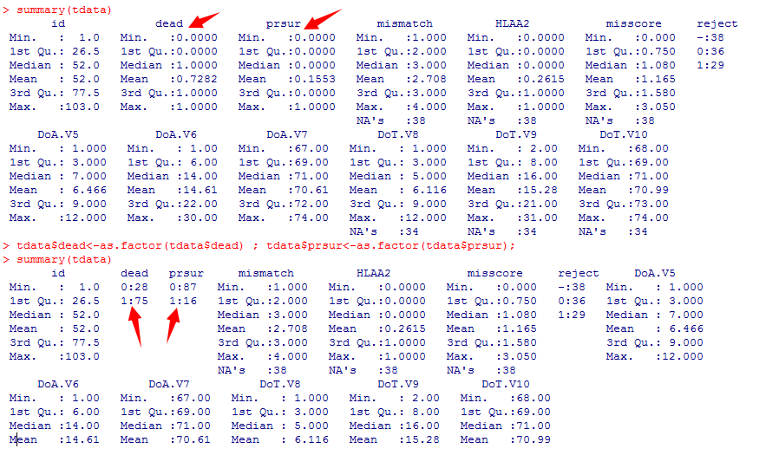
Data Exploration
Factorization: make numeric data to be factor
Notes:
cause we know that data items dead and prsur are catelogical data they are meaningless for 1st Qu,mean, so we need to transform them to factor!! And via function summary() we could see the their frequencies.
Different data has different attributes which are of concern !!
dead: dead or alive
prsur: prior surgery 1=yes,0=no

Slide 7
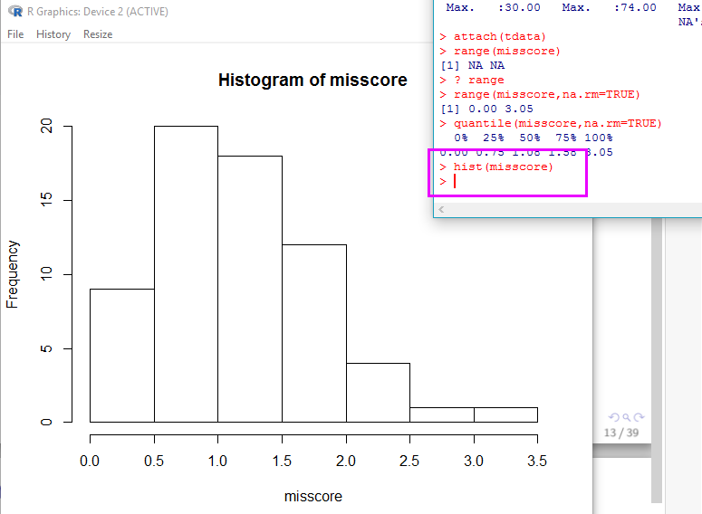
Data Visualization
histogram

Slide 8

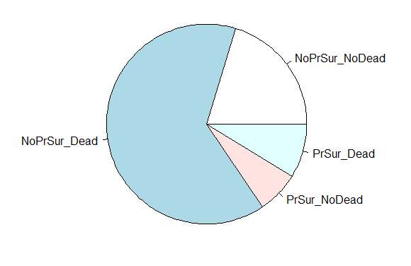
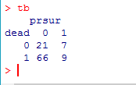
Data Visualization
pie box
Notes:
table print

Slide 9
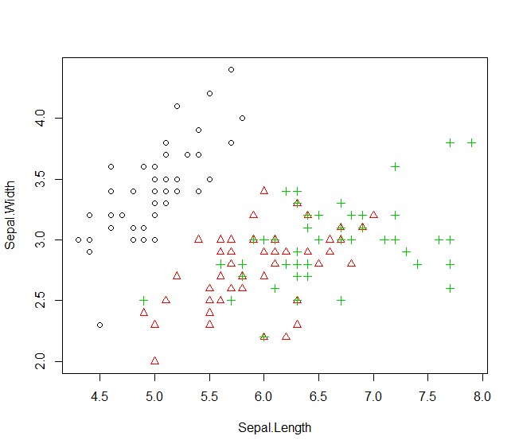
Data Visualization
Scatterplot plot()
with(iris,plot(Sepal.Length,Sepal.Width,col=Species,pch=as.numeric(Species)))
more details about plot
help(plot) or ?plot
x data
y data
using species labels als colors
use species as patch to draw
Notes:
with(data, exp,...) : Evaluate an R expression in an environment constructed from data, possibly modifying (a copy of) the original data. We could understand it like a box in which an exp will be calculated.

Slide 10
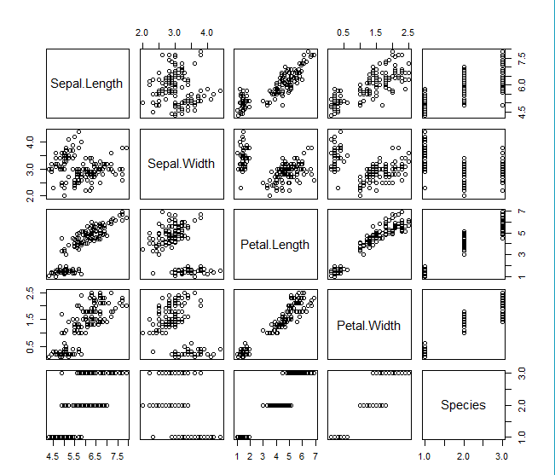
Data Visualization
Matrix of Scatter Plots
pairs(iris)

Slide 11
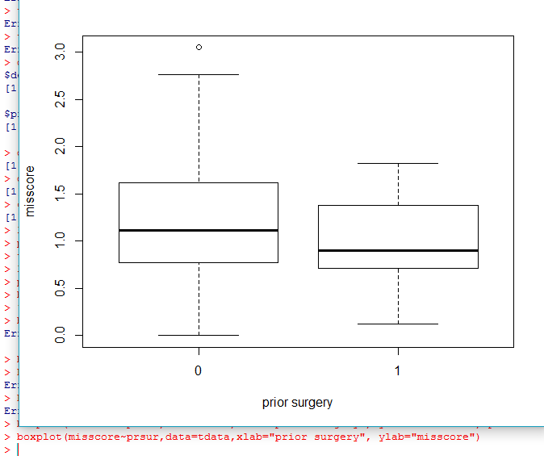
Data Visualization -- boxplot
boxplot(formula, data = NULL, ..., subset, na.action = NULL)
Formula: y~grp: e.g. misscore~prsur, it means where misscore is a numeric vector of data values to be split into groups according to the grouping variables prsur
xlab: add x axis label
ylab: add y axis label
boxplot(misscore~prsur,
data=tdata,
xlab="prior surgery",
ylab="misscore")
Notes:
boxplot: Produce box-and-whisker plot(s) of the given (grouped) values.
0 in the x-axis means without prior surgery the data distribution of misscore,
1 in the x-axis means with prior surgery how the misscore is distributed

Slide 12
Data Cleaning
handling noisy, erroneous, missing ,or irrelevant data
Data Types in R: Numerical
Catalogical
NA --Not Available
NaN-- Not a Number
Cleaning Methods:
1) using extreme number to fill, e.g 0
2) using mean
3) using mode: the frequenciest number

Slide 13
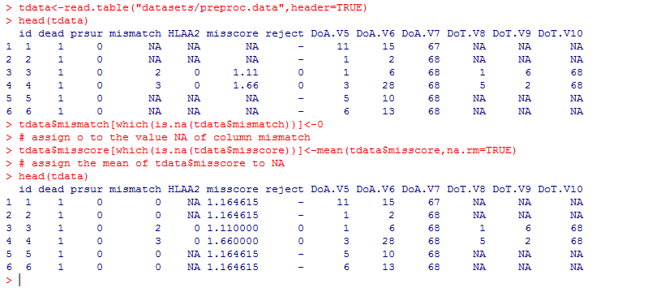
Data Cleaning

Slide 14
Data Sampling Definition
Sampling is the process of selecting representative which indicates the whole data set. A fairly modest-sized sample can sufficiently characterize a much larger population[3].
Advantages
Inference/Generalization: exhaustively search the databases often leave no data from which to develop inferences//data for validation
Speed and Efficiency: smaller data set, lower cost
Quality of the Findings: concentrate on main features //benefit data exploration
Notes:
http://sce.uhcl.edu/boetticher/ML_DataMining/SAS-SEMMA.pdf
Exploring a representative sample is easier, more efficient, and can be as accurate as exploring
the entire database. After the initial sample is explored, some preliminary models can
be fitted and assessed.
Inference/Generalization
Data mining systems that exhaustively search the databases often leave no data from which to develop inferences.
Processing all of the data also leaves no holdout data with which to test the model for explanatory power on
new events. In addition, using all of the data leaves no way to validate findings on data unseen by the model. In other words, there is no room left to accomplish the goal of inference.
Speed and Efficiency
Perhaps the most persistent problems concerning the processing of large databases are
speed and cost. Analytical routines required for exploration and modeling run faster on
samples than on the entire database. Alternatively, little variation might exist in the data for many of the variables; the records
are very similar in many ways. Performing computationally intensive processing on the
entire database might provide no additional information beyond what can be obtained
from processing a small, well-chosen sample.
Quality of the Findings
Using exhaustive methods when developing predictive models may actually create more
work by revealing spurious relationships.
Visualization
Data visualization and exploration facilitate understanding of the data.9 To better
understand a variable, univariate plots of the distribution of values are useful.

Slide 15
Data Sampling Types
Simple Random Sampling
N-th Record Sampling
First N Sampling
Cluster Sampling
Each cluster of database records has the same chance of being included in the sample. Each cluster consists of records that are similar in some way.
Stratified Random Sampling
Within each stratum, all records have the same chance of being included in the sample. Across the strata, records generally do not have the same probability of being included in the sample.
Notes:
Simple Random Sampling
Each data record has the same chance of being included in the sample.
N-th Record Sampling
Each n-th record is included in the sample such as every 100th record. This type of
sampling is also called systematic sampling. For structured data tables, only a portion of the structure may be captured.
First N Sampling
The first n records are included in the sample.
Cluster Sampling
Each cluster of database records has the same chance of being included in the sample. Each cluster consists of records that are similar in some way.
Stratified Random Sampling
Within each stratum, all records have the same chance of being included in the sample. Across the strata, records generally do not have the same probability of being included in the sample.
Stratified random sampling is performed to preserve the strata proportions of the
population within the sample.

Slide 16
Data Sampling Examples
sample(x, size, replace = FALSE, prob = NULL)
sample.int(n, size = n, replace = FALSE, prob = NULL)
package: base in R
x: either a vector from which to choose, or a postive integer
n:a positive number, the number of items to choose from
size: a non-negative integer giving the number of items to choose
replace: Should sampling be with replacement?
prob: a vector of probability weights for obtaining the elements of the vector being sampled

Slide 17
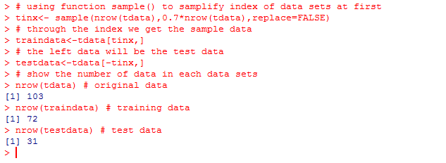
Data Sampling Examples
# using function sample() to samplify index of data sets at first
tinx<- sample(nrow(tdata),0.7*nrow(tdata),replace=FALSE)
# through the index we get the sample data
traindata<-tdata[tinx,]
# the left data will be the test data
testdata<-tdata[-tinx,]

Slide 18




Normalization & Standardization
Data values can be scaled into the range of [0,1] which is called normalization.
Data standardization will transform data to have zero mean and unit variance.

Slide 19
Packages caret for Preprocess
install.packages(“caret”)
library(caret)
The caret package (short for _C_lassification _A_nd _RE_gression _T_raining) is a set of functions that attempt to streamline the process for creating predictive models. The package contains tools for:
data splitting
pre-processing
feature selection
model tuning using resampling
variable importance estimation

Slide 20
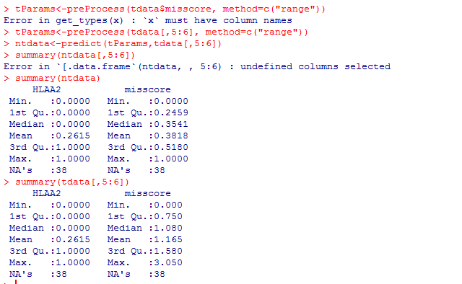
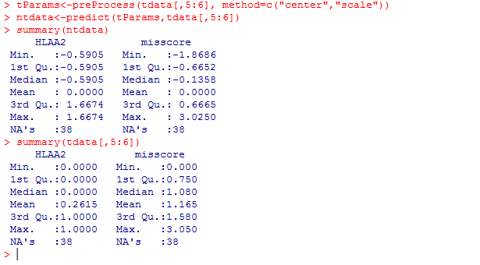
caret for Preprocess
data normalization
data standardization
Notes:
The scale transform calculates the standard deviation for an attribute and divides each value by that standard deviation.
The scale transform calculates the standard deviation for an attribute and divides each value by that standard deviation.

Slide 21
References
[1]http://lib.stat.cmu.edu/datasets/stanford
[2] Crowley and Hu, Covariance Analysis of Heart Transplant Survival
Data, J. Amer. Stat. Assoc, vol 72 (1977), p 27-36
[3 ] http://sce.uhcl.edu/boetticher/ML_DataMining/SAS-SEMMA.pdf
[4] http://www.rdatamining.com/
[5] An Introduction to R

